Slide 1
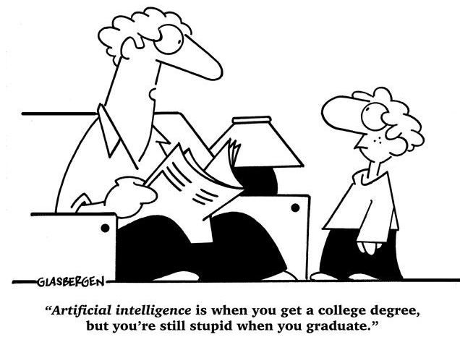
Variants of Neural Networks： CNN & RNN
汤斯亮（Siliang Tang）
siliang@zju.edu.cn

Slide 2
Variants of Neural Networks
Convolutional Neural Network (CNN)
Recurrent Neural Network (RNN)
Widely used in image processing

Slide 3
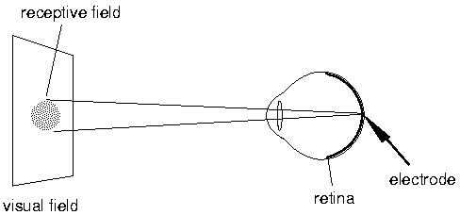
A Brief History of CNN
每只人类的眼睛有10⁸个视觉接收器（比如视锥，视杆等等），但是我们只有10⁶个视觉神经。因此，可知每一个视觉神经都接收来自多个视觉接受细胞的输入。
视觉神经不是简单的告诉大脑光线被检测到，而是感受光线和黑暗之间的对比，也就是形状被感受到了。
我们的每个单个神经元并不会对整个图像做出回应，而是只对其负责的receptive filed响应。

Slide 4
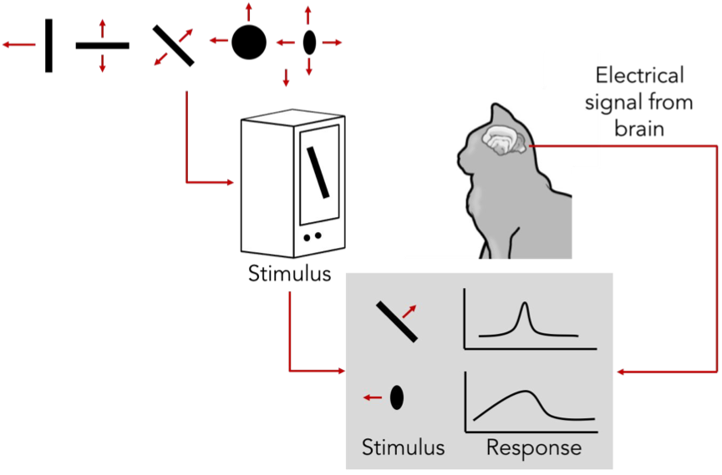
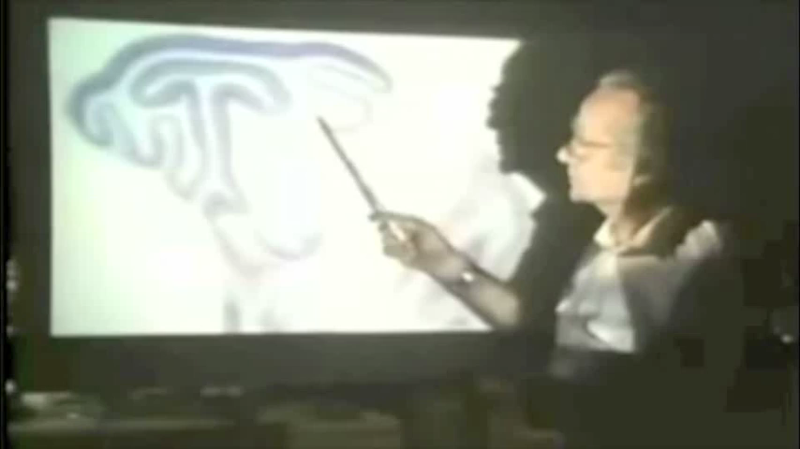
A Brief History of CNN
Hubel & Wiesel (1981年诺贝尔奖)
1959
RECEPTIVE FIELDS OF SINGLE NEURONES IN THE CAT’S STRIATE CORTEX
1962
RECEPTIVE FIELDS, BINOCULAR INTERACTION AND FUNCTIONAL ARCHITECTURE IN THE CAT’S VISUAL CORTEX
1968...

Slide 5
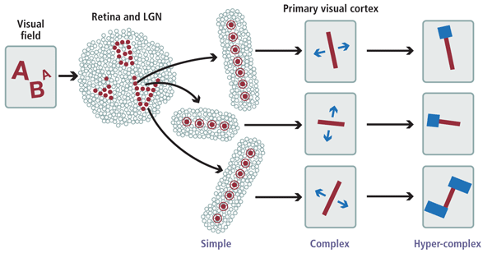
A Brief History of CNN
Hierarchical organization
Simple cells: response to light orientation
Complex cells: response to light orientation and movement
Hypercomplex cells: response to movement with an endpoint
LGN会响应一个微小的光点，但是对漫反射没什么回应
不再响应光点，但是对亮暗的线条有响应
不再对区域敏感
对端点敏感

Slide 6
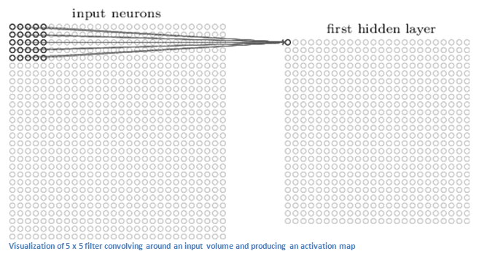
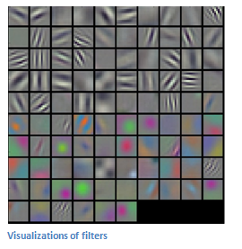
A Brief History of CNN
Local connection
Translation invariance
Filtering

Slide 7
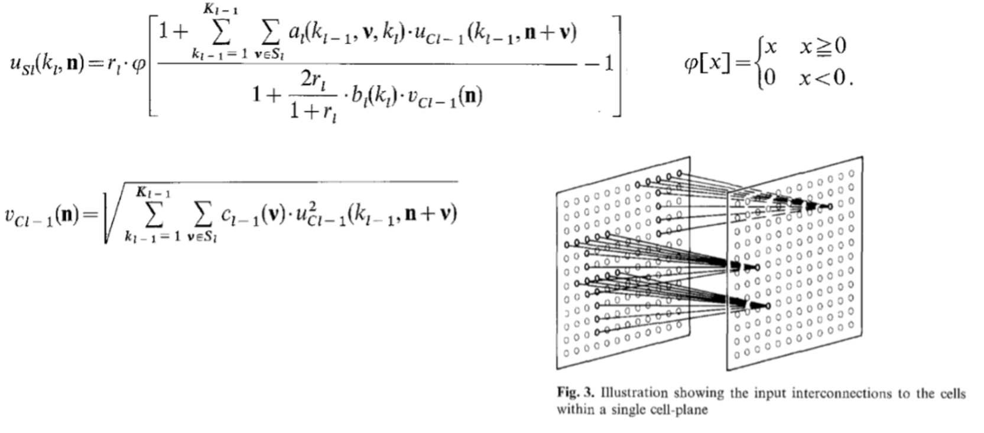
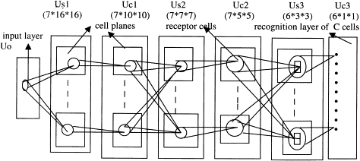
A Brief History of CNN
Neocognitron [Kunihiko Fukushima, 1980]
将脑神经科学的结构在做了计算机模拟
提出了现在CNN常用的step-by-step的filter
使用ReLU来给网络提供非线性
采用平均池化来做downsampling
保证了网络的平移不变性
实现了稀疏交互

Slide 8
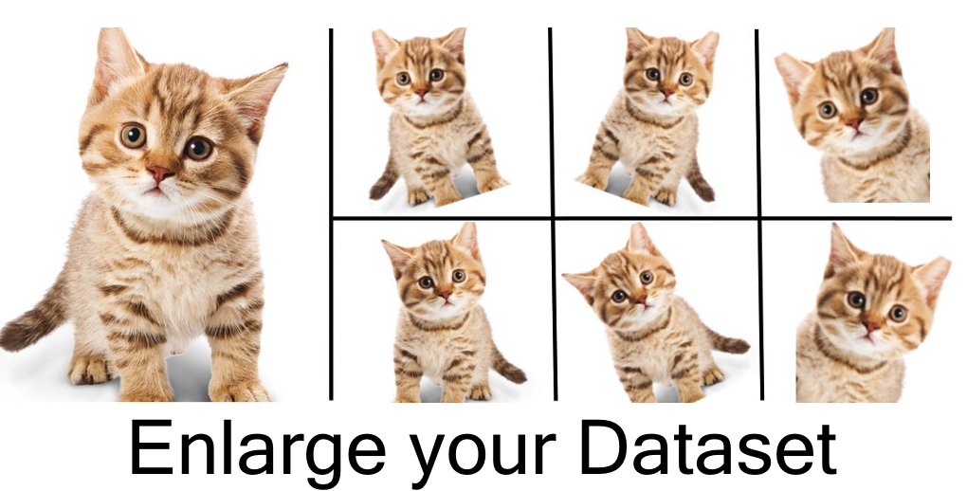
A Brief History of CNN
BP for CNN 1990 [LeCun et al. ]
提出了权值共享，这个操作减少了自由变量的数量，也就减少了过拟合的风险，提高了泛化能力。参数的减少同时也加速了训练过程。
Cresceptron 1992 [Weng et al. ]
Data Augmentation
最大池化

Slide 9
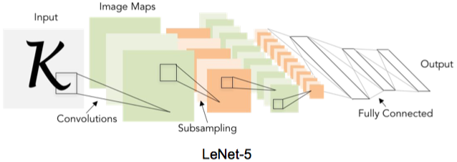
A Brief History of CNN
Gradient-based learning applied to document recognition [LeCun, Bottou, Bengio, Haffner 1998]
使用了tanh作为激活函数

Slide 10
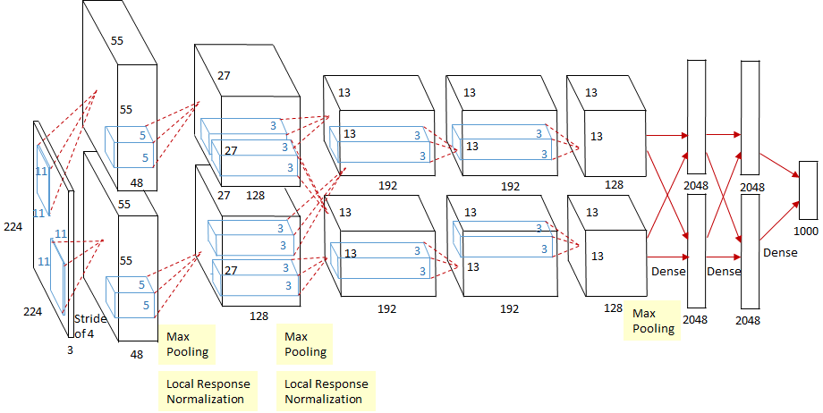
A Brief History of CNN
AlexNet: ImageNet Classification with Deep Convolutional Neural Networks [Krizhevsky, Sutskever, Hinton, 2012]

Slide 11

Today: CNN are everywhere!
Self-driving

Slide 12
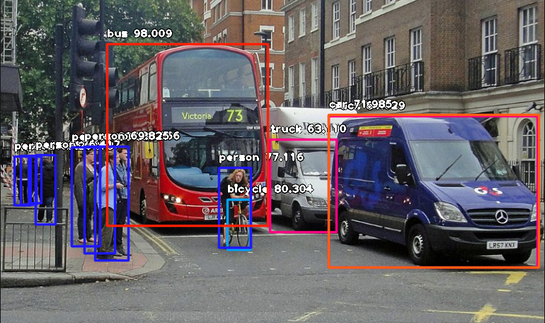
Today: CNN are everywhere!
Object Detection

Slide 13
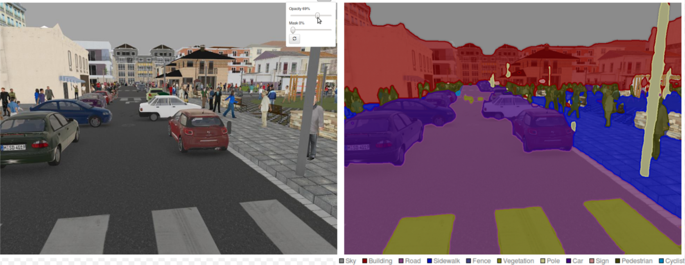
Today: CNN are everywhere!
Segmentation

Slide 14
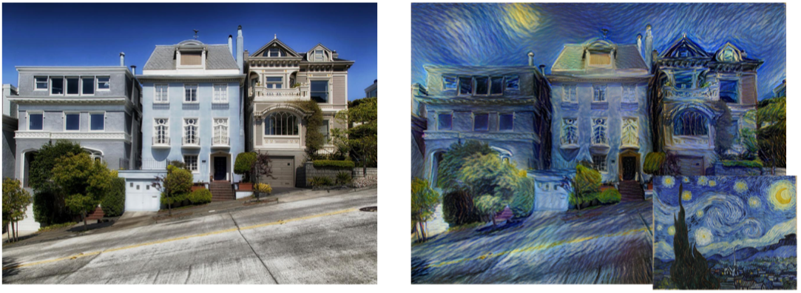
Today: CNN are everywhere!
Image Style Transfer

Slide 15

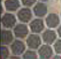




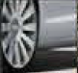
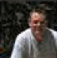

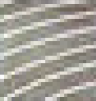
Why CNN for Image?
[Zeiler, M. D., ECCV 2014]
……
……
……
……
……
……
Represented as pixels
……
The most basic classifiers
Use 1st layer as module to build classifiers
Use 2nd layer as module ……
Can the network be simplified by considering the properties of images?

Slide 16


Why CNN for Image
Some patterns are much smaller than the whole image
A neuron does not have to see the whole image to discover the pattern.
Connecting to small region with less parameters
“beak” detector

Slide 17

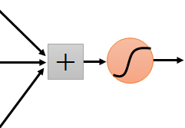
Why CNN for Image
The same patterns appear in different regions.
“upper-left beak” detector
Do almost the same thing
They can use the same set of parameters.
“middle beak” detector

Slide 18


Why CNN for Image
Subsampling the pixels will not change the object
bird
bird
subsampling
We can subsample the pixels to make image smaller
Less parameters for the network to process the image

Slide 19

The whole CNN
cat dog ……
Convolution
Max Pooling
Can repeat many times
Fully Connected Feedforward network
Convolution
Max Pooling
Flatten

Slide 20
The whole CNN
Property 1
Some patterns are much smaller than the whole image
Convolution
Property 2
Max Pooling
The same patterns appear in different regions.
Can repeat many times
Property 3
Convolution
Subsampling the pixels will not change the object
Max Pooling
Flatten

Slide 21
The whole CNN
cat dog ……
Convolution
Max Pooling
Can repeat many times
Fully Connected Feedforward network
Convolution
Max Pooling
Flatten

Slide 22
CNN – Convolution
Those are the network parameters to be learned.
1 | -1 | -1
-1 | 1 | -1
-1 | -1 | 1
1 | 0 | 0 | 0 | 0 | 1
0 | 1 | 0 | 0 | 1 | 0
0 | 0 | 1 | 1 | 0 | 0
1 | 0 | 0 | 0 | 1 | 0
0 | 1 | 0 | 0 | 1 | 0
0 | 0 | 1 | 0 | 1 | 0
Filter 1
Matrix
-1 | 1 | -1
-1 | 1 | -1
-1 | 1 | -1
Filter 2
Matrix
……
6 x 6 image
Each filter detects a small pattern (3 x 3).
Property 1

Slide 23
CNN – Convolution
1 | -1 | -1
-1 | 1 | -1
-1 | -1 | 1
Filter 1
stride=1
1 | 0 | 0 | 0 | 0 | 1
0 | 1 | 0 | 0 | 1 | 0
0 | 0 | 1 | 1 | 0 | 0
1 | 0 | 0 | 0 | 1 | 0
0 | 1 | 0 | 0 | 1 | 0
0 | 0 | 1 | 0 | 1 | 0
3
-1
6 x 6 image

Slide 24
CNN – Convolution
1 | -1 | -1
-1 | 1 | -1
-1 | -1 | 1
Filter 1
If stride=2
1 | 0 | 0 | 0 | 0 | 1
0 | 1 | 0 | 0 | 1 | 0
0 | 0 | 1 | 1 | 0 | 0
1 | 0 | 0 | 0 | 1 | 0
0 | 1 | 0 | 0 | 1 | 0
0 | 0 | 1 | 0 | 1 | 0
3
-3
We set stride=1 below
6 x 6 image

Slide 25
CNN – Convolution
1 | -1 | -1
-1 | 1 | -1
-1 | -1 | 1
Filter 1
stride=1
1 | 0 | 0 | 0 | 0 | 1
0 | 1 | 0 | 0 | 1 | 0
0 | 0 | 1 | 1 | 0 | 0
1 | 0 | 0 | 0 | 1 | 0
0 | 1 | 0 | 0 | 1 | 0
0 | 0 | 1 | 0 | 1 | 0
3
-1
-3
-1
-3
1
0
-3
-3
-3
0
1
3
-2
-2
-1
6 x 6 image
Property 2

Slide 26
CNN – Convolution
-1 | 1 | -1
-1 | 1 | -1
-1 | 1 | -1
Filter 2
stride=1
Do the same process for every filter
1 | 0 | 0 | 0 | 0 | 1
0 | 1 | 0 | 0 | 1 | 0
0 | 0 | 1 | 1 | 0 | 0
1 | 0 | 0 | 0 | 1 | 0
0 | 1 | 0 | 0 | 1 | 0
0 | 0 | 1 | 0 | 1 | 0
3
-1
-3
-1
-1
-1
-1
-1
-3
1
0
-3
-1
-1
-2
1
Feature
Map
-3
-3
0
1
-1
-1
-2
1
3
-2
-2
-1
6 x 6 image
-1
0
-4
3
4 x 4 image

Slide 27
CNN – Zero Padding
1 | -1 | -1
-1 | 1 | -1
-1 | -1 | 1
Filter 1
0
0
0
0
1 | 0 | 0 | 0 | 0 | 1
0 | 1 | 0 | 0 | 1 | 0
0 | 0 | 1 | 1 | 0 | 0
1 | 0 | 0 | 0 | 1 | 0
0 | 1 | 0 | 0 | 1 | 0
0 | 0 | 1 | 0 | 1 | 0
0
You will get another 6 x 6 images in this way
0
0
Zero padding
0
0
0
6 x 6 image

Slide 28
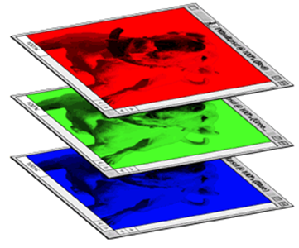
CNN – Colorful image
1 | -1 | -1
-1 | 1 | -1
-1 | -1 | 1
-1 | 1 | -1
-1 | 1 | -1
-1 | 1 | -1
1 | -1 | -1
-1 | 1 | -1
-1 | -1 | 1
-1 | 1 | -1
-1 | 1 | -1
-1 | 1 | -1
1 | -1 | -1
-1 | 1 | -1
-1 | -1 | 1
-1 | 1 | -1
-1 | 1 | -1
-1 | 1 | -1
Filter 1
Filter 2
Colorful image
1 | 0 | 0 | 0 | 0 | 1
0 | 1 | 0 | 0 | 1 | 0
0 | 0 | 1 | 1 | 0 | 0
1 | 0 | 0 | 0 | 1 | 0
0 | 1 | 0 | 0 | 1 | 0
0 | 0 | 1 | 0 | 1 | 0
1 | 0 | 0 | 0 | 0 | 1
0 | 1 | 0 | 0 | 1 | 0
0 | 0 | 1 | 1 | 0 | 0
1 | 0 | 0 | 0 | 1 | 0
0 | 1 | 0 | 0 | 1 | 0
0 | 0 | 1 | 0 | 1 | 0
1 | 0 | 0 | 0 | 0 | 1
0 | 1 | 0 | 0 | 1 | 0
0 | 0 | 1 | 1 | 0 | 0
1 | 0 | 0 | 0 | 1 | 0
0 | 1 | 0 | 0 | 1 | 0
0 | 0 | 1 | 0 | 1 | 0

Slide 29
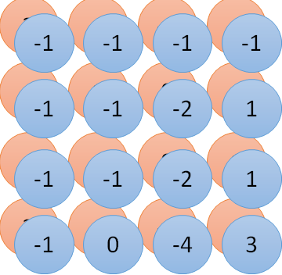
Convolution v.s. Fully Connected
1 | 0 | 0 | 0 | 0 | 1
0 | 1 | 0 | 0 | 1 | 0
0 | 0 | 1 | 1 | 0 | 0
1 | 0 | 0 | 0 | 1 | 0
0 | 1 | 0 | 0 | 1 | 0
0 | 0 | 1 | 0 | 1 | 0
1 | -1 | -1
-1 | 1 | -1
-1 | -1 | 1
-1 | 1 | -1
-1 | 1 | -1
-1 | 1 | -1
convolution
image
1 | 0 | 0 | 0 | 0 | 1
0 | 1 | 0 | 0 | 1 | 0
0 | 0 | 1 | 1 | 0 | 0
1 | 0 | 0 | 0 | 1 | 0
0 | 1 | 0 | 0 | 1 | 0
0 | 0 | 1 | 0 | 1 | 0
Fully-connected
……
……

Slide 30
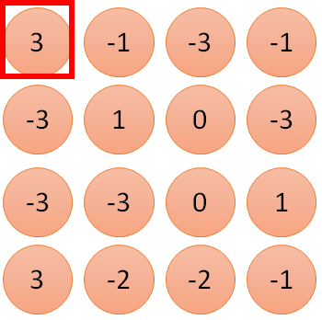
1 | -1 | -1
-1 | 1 | -1
-1 | -1 | 1
1:
1
Filter 1
2:
0
3:
0
3
4:
0
1 | 0 | 0 | 0 | 0 | 1
0 | 1 | 0 | 0 | 1 | 0
0 | 0 | 1 | 1 | 0 | 0
1 | 0 | 0 | 0 | 1 | 0
0 | 1 | 0 | 0 | 1 | 0
0 | 0 | 1 | 0 | 1 | 0
…
7:
0
8:
1
9:
0
10:
0
…
13:
0
6 x 6 image
14:
0
Less parameters!
15:
Only connect to 9 input, not fully connected
1
16:
1
…

Slide 31
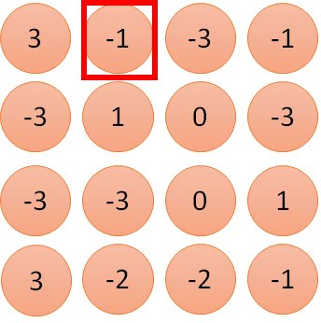
1 | -1 | -1
-1 | 1 | -1
-1 | -1 | 1
1:
1
Filter 1
2:
0
3:
0
3
4:
0
1 | 0 | 0 | 0 | 0 | 1
0 | 1 | 0 | 0 | 1 | 0
0 | 0 | 1 | 1 | 0 | 0
1 | 0 | 0 | 0 | 1 | 0
0 | 1 | 0 | 0 | 1 | 0
0 | 0 | 1 | 0 | 1 | 0
…
7:
0
8:
1
-1
9:
0
10:
0
…
13:
0
6 x 6 image
14:
0
Less parameters!
15:
1
16:
1
Shared weights
Even less parameters!
…

Slide 32
The whole CNN
cat dog ……
Convolution
Max Pooling
Can repeat many times
Fully Connected Feedforward network
Convolution
Max Pooling
Flatten

Slide 33
CNN – Max Pooling
1 | -1 | -1
-1 | 1 | -1
-1 | -1 | 1
-1 | 1 | -1
-1 | 1 | -1
-1 | 1 | -1
Filter 1
Filter 2
3
-1
-3
-1
-1
-1
-1
-1
-3
1
0
-3
-1
-1
-2
1
-3
-3
0
1
-1
-1
-2
1
3
-2
-2
-1
-1
0
-4
3

Slide 34
CNN – Max Pooling
New image
but smaller
1 | 0 | 0 | 0 | 0 | 1
0 | 1 | 0 | 0 | 1 | 0
0 | 0 | 1 | 1 | 0 | 0
1 | 0 | 0 | 0 | 1 | 0
0 | 1 | 0 | 0 | 1 | 0
0 | 0 | 1 | 0 | 1 | 0
Conv
3
0
-1
1
Max
Pooling
3
1
0
3
2 x 2 image
6 x 6 image
Each filter
is a channel

Slide 35
The whole CNN
3
0
-1
1
Convolution
3
1
0
3
Max Pooling
Can repeat many times
A new image
Convolution
Smaller than the original image
The number of the channel is the number of filters
Max Pooling

Slide 36
The whole CNN
cat dog ……
Convolution
Max Pooling
A new image
Fully Connected Feedforward network
Convolution
Max Pooling
A new image
Flatten

Slide 37
Flatten
3
0
1
3
0
-1
1
3
3
1
-1
0
3
Flatten
1
Fully Connected Feedforward network
0
3

Slide 38
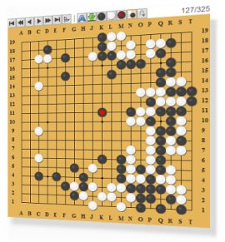
More Application: Playing Go
Network
Next move
(19 x 19 positions)
19 x 19 matrix (image)
19 x 19 vector
19 x 19 vector
Fully-connected feedforward network can be used
Black: 1
white: -1
none: 0
But CNN performs much better.

Slide 39
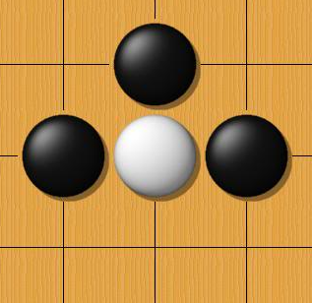
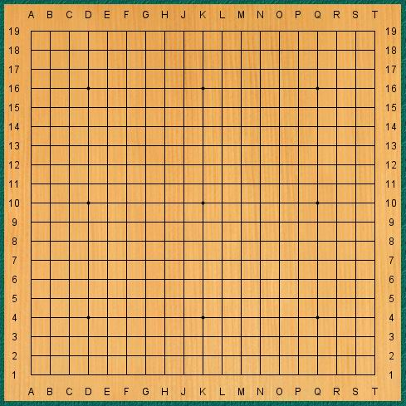
Why CNN for playing Go?
Some patterns are much smaller than the whole image
The same patterns appear in different regions.
Alpha Go uses 5 x 5 for first layer

Slide 40
Variants of Neural Networks
Convolutional Neural Network (CNN)
Recurrent Neural Network (RNN)
Neural Network with Memory

Slide 41
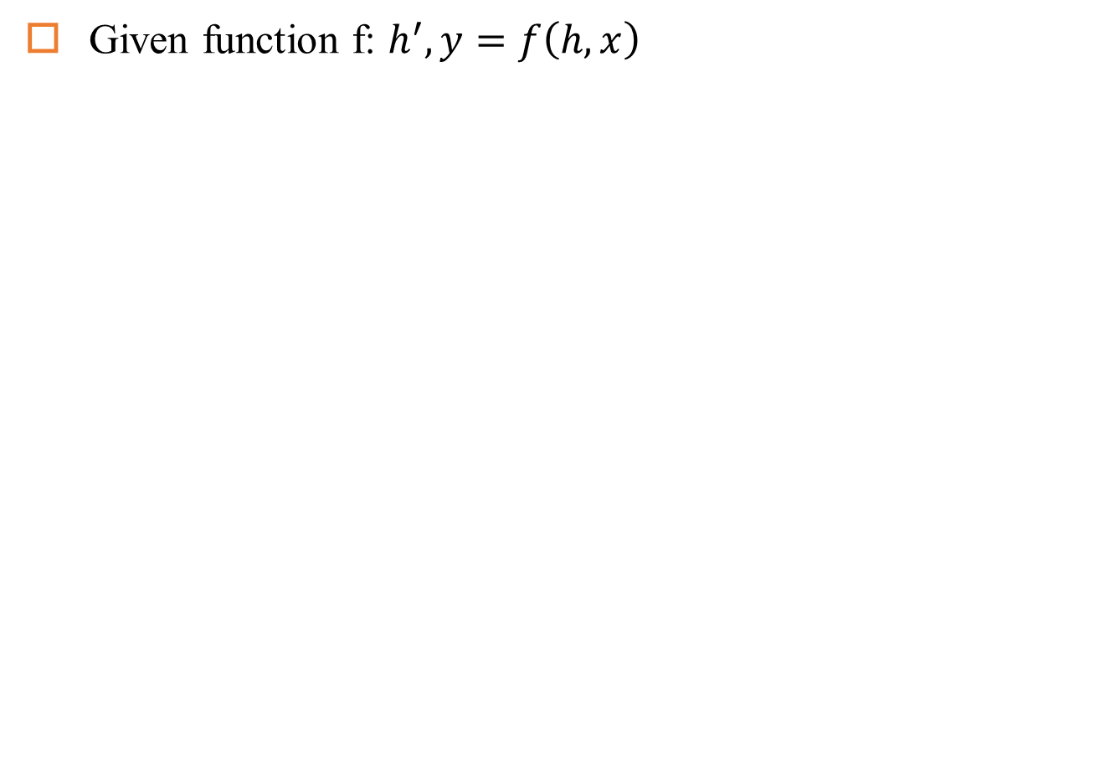
Recurrent Neural Network
Given function f: $h^{′},y=f\left(h,x\right)$
h and h’ are vectors with the same dimension
y¹
y²
y³
h⁰
f
h¹
f
h²
f
h³
……
x¹
x²
x³
No matter how long the input/output sequence is, we only need one function f

Slide 42
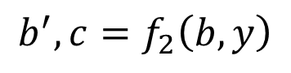
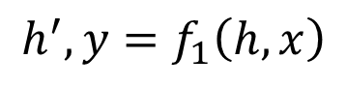
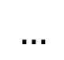
Deep RNN
$$h^{′},y=f_{1}\left(h,x\right)$$
$$b^{′},c=f_{2}\left(b,y\right)$$
$$…$$
…
…
…
c¹
c²
c³
b⁰
f₂
b¹
f₂
b²
f₂
b³
……
y¹
y²
y³
h⁰
f₁
h¹
f₁
h²
f₁
h³
……
x¹
x²
x³

Slide 43
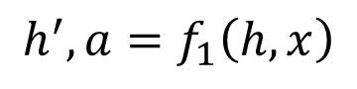
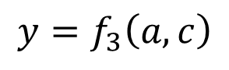
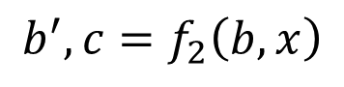
Bidirectional RNN
$$h^{′},a=f_{1}\left(h,x\right)$$
$$b^{′},c=f_{2}\left(b,x\right)$$
x¹
x²
x³
b⁰
f₂
b¹
f₂
b²
f₂
b³
c¹
c²
c³
y¹
y²
y³
$$y=f_{3}\left(a,c\right)$$
f₃
f₃
f₃
a¹
a²
a³
h⁰
f₁
h¹
f₁
h²
f₁
h³
x¹
x²
x³

Slide 44
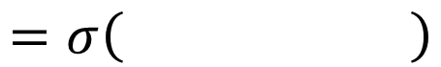
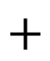
Naïve RNN
Given function f: $h^{′},y=f\left(h,x\right)$
y
h'
W^{h}
h
W^{i}
x
$$+$$
$$=σ\left( \right)$$
h
f
h'
y
Wº
h'
$$=σ\left( \right)$$
x
softmax
Ignore bias here

Slide 45
LSTM
y^{t}
LSTM
c^{t}
y^{t}
c^{t-1}
Naive
h^{t}
h^{t}
h^{t-1}
h^{t-1}
x^{t}
x^{t}
c changes slowly
c^{t} is c^{t-1} added by something
h changes faster
h^{t} and h^{t-1} can be very different

Slide 46
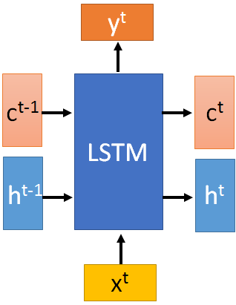
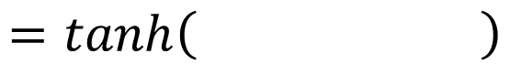
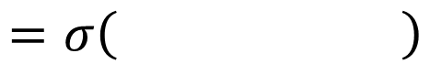
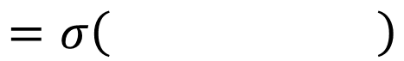
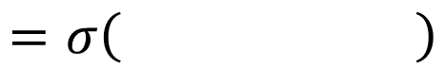
x^{t}
z
W
$$=tanh\left( \right)$$
h^{t-1}
c^{t-1}
x^{t}
z^{i}
W^{i}
$$=σ\left( \right)$$
h^{t-1}
Input
gate
x^{t}
z^{f}
W^{f}
$$=σ\left( \right)$$
h^{t-1}
z^{f}
z^{i}
z
zº
forget
gate
x^{t}
zº
Wº
$$=σ\left( \right)$$
h^{t-1}
x^{t}
h^{t-1}
output
gate

Slide 47
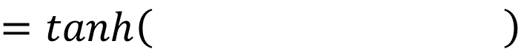
x^{t}
z
W
h^{t-1}
$$=tanh\left( \right)$$
c^{t-1}
c^{t-1}
diagonal
“peephole”
zº
z^{f}
z^{i}
obtained by the same way
z^{f}
z^{i}
z
zº
h^{t-1}
x^{t}

Slide 48

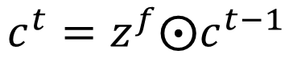

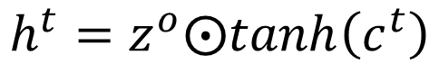
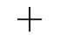
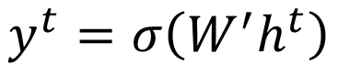
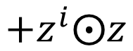

y^{t}
c^{t-1}
c^{t}
$$⨀$$
$$＋$$
$$⨀$$
$$c^{t}=z^{f}⨀c^{t−1}$$
$$+z^{i}⨀z$$
$$⨀$$
$$h^{t}=z^{o}⨀tanh\left(c^{t}\right)$$
z^{f}
z^{i}
z
zº
$$y^{t}=σ\left(W^{′}h^{t}\right)$$
h^{t-1}
x^{t}
h^{t}

Slide 49




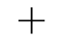

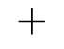

LSTM
y^{t}
y^{t+1}
c^{t-1}
c^{t}
c^{t+1}
$$⨀$$
$$＋$$
$$⨀$$
$$⨀$$
$$＋$$
$$⨀$$
$$⨀$$
$$⨀$$
z^{f}
z^{i}
z
zº
z^{f}
z^{i}
z
zº
h^{t+1}
h^{t-1}
x^{t}
h^{t}
x^{t+1}

Slide 50
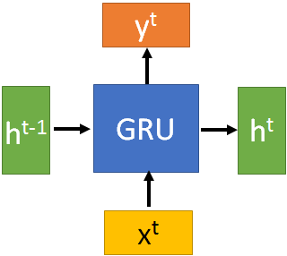






GRU
$$h^{t}=z⨀h^{t−1}+\left(1−z\right)⨀h^{′}$$
y^{t}
h^{t-1}
$$⨀$$
$$＋$$
h^{t}
$$⨀$$
1-
$$⨀$$
reset
update
r
z
h'
h^{t-1}
x^{t}
x^{t}

Slide 51

LSTM: A Search Space Odyssey

Slide 52


LSTM: A Search Space Odyssey
Standard LSTM works well
Simply LSTM: coupling input and forget gate, removing peephole
Forget gate is critical for performance
Output gate activation function is critical

Slide 53
Any Questions?

